Slide 1

Institute of technology of Cambodia
Double Hashing
Subject: Data Structure & Programming
Professor: Mr. Chan Sophal
Class: I2-AMS1(2021-2022)

Slide 2

Group4 Members
Lim Sengly
Lun Tula
Leat Senglong
Ngeav Bunat
Hok Ratanak
Lim Sunheng
Eab Pisey
Hon Ratana

Slide 3
Contents
01
04
02
05
03
06
Definition
Functions
Coding
Advantages
Disadvantages
Conclusion

Slide 4
01
Definition
01
02
03
04
Double hashing is a computer programming technique used in conjunction with open addressing in hash tables to resolve hash collisions, by using a secondary hash of the key as an offset when a collision occurs. Double hashing uses the idea of applying a second hash function to key when a collision occurs
05
06

Slide 5
02
Functions
01
02
03
04
05
06

Slide 6
The function denotes double hashing
(H1(K)+i*H2(K))% tableSize
(H1(K) = K % tablesize
H2(K) = cp –(K % cp)

Slide 7
Example:
+ Let us understand double hashing using an example:
Keys, K = {20, 34, 45, 70, 56}
Let the size of the table be 11. So the first hash function will be given by:
H1(K) = K % 11
For the second hash function, cp should be chosen in such a way that HCF(cp, 11) = 1
So, let cp = 8
The second hash function will be given by:
H2(K) = 8 - (K % 8)
And the hash function will be given by:
(H1(K) + i * H2(K)) % 11

Slide 8
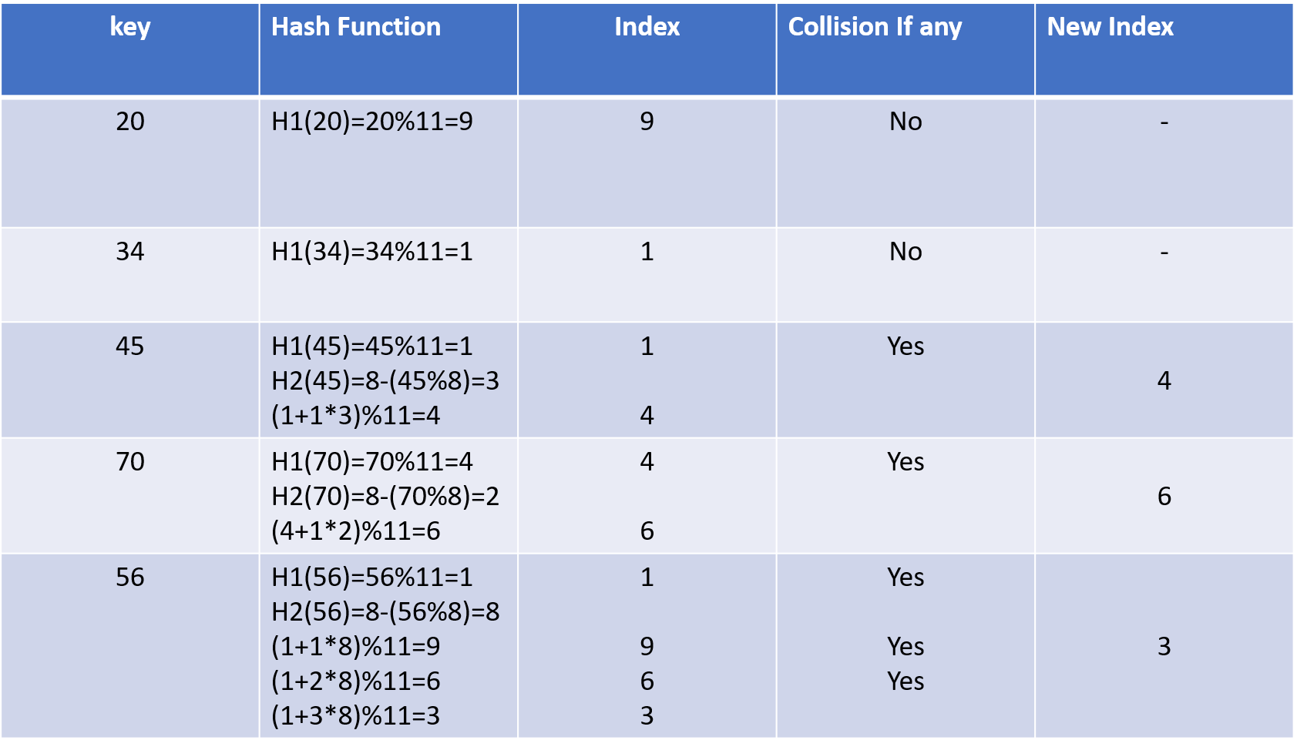

Slide 9
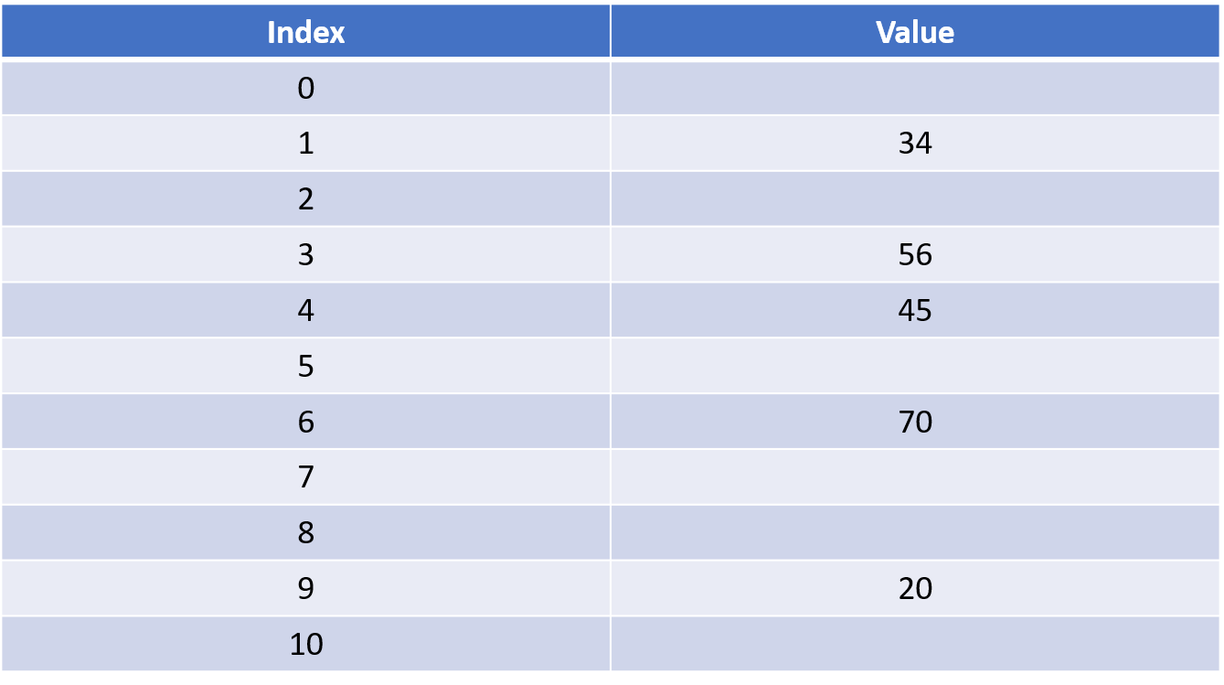

Slide 10
Time complexity
-Best case
-Average case
-Worst case
Space Complexity
Hash tables usually have a maximum capacity of some constant multiplied by N (the constant is predetermined and N is the total number of elements.) Thus the space complexity of double hashing is O(N).

Slide 11
03
Coding
01
02
03
04
05
06

Slide 12
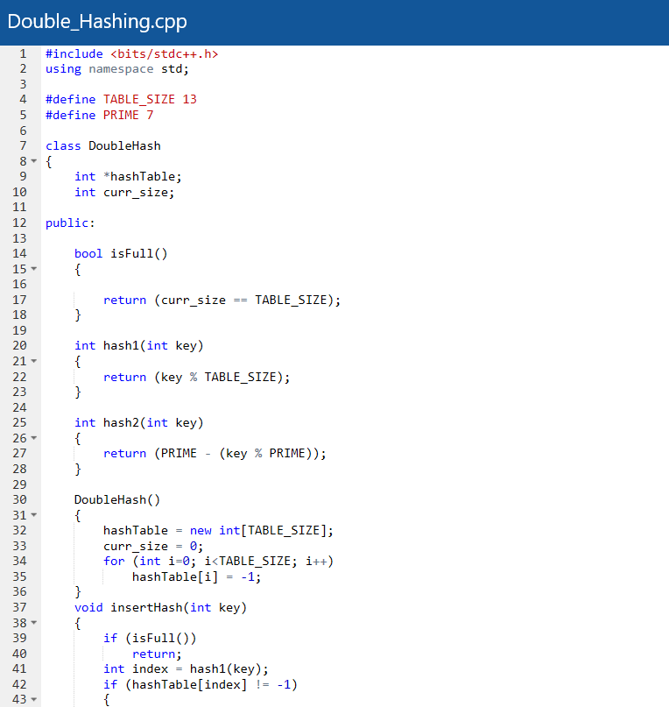
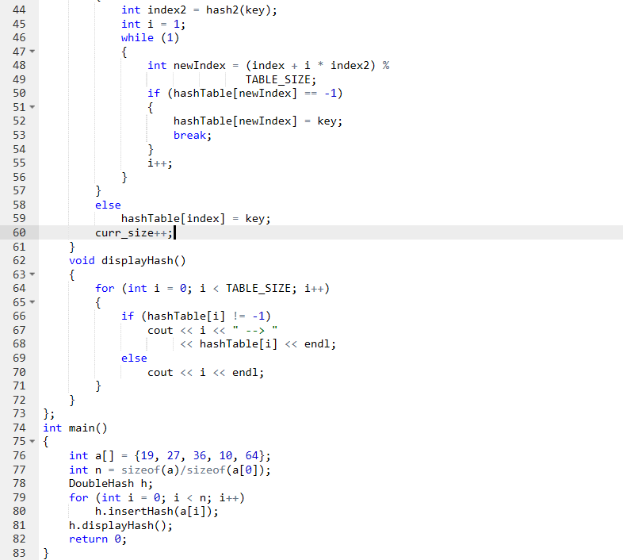

Slide 13
04
Advantages
01
02
03
04
+ It is one of the best form of probing, producing a uniform distribution of records throughout a hash table.
+ This technique does not yield any clusters.
+ It is one of effective method for resolving collisions..
05
06

Slide 14
05
Disadvantages
01
02
03
04
+ It has poor cache performance but no clustering.
+ It requires more computation time as two hash functions need to be computed.
05
06

Slide 15
Conclusion
01
02
In the process of searching by double hashing technique can be concluded that the value will be divided into two tables to place the value in the main table and overflow, and for the search process is done first once in the main table and continued on the table overflow until all the numbers listed in the table are processed.
03
04
05
06

Slide 16
Resources
01
https://iq.opengenus.org/double-hashing/amp/
02
03
04
05
06

Slide 17
Thanks!
01
02
03
Do you have any questions?
04
05
06

